Slide 1
Automotive Axles Limited
February 2019

Slide 2
Snapshot FY19
FY19: REVENUE - YTD performance: ₹1,460 Cr; FY Outlook : ₹1,900 to 1,950 Cr
EBIDTA - YTD performance: ₹173 Cr (11.8%); FY Outlook: 11.5% to 11.7%
PBT - YTD performance: ₹136 Cr (9.3%); FY Outlook: 9.0% to 9.2%
MANUFACTURING LOCATIONS - 3 Manufacturing locations: Mysore, Jamshedpur, Pantnagar
EQUITY SHARE: Meritor Inc, USA – 35.5%, Kalyani Group – 35.5%, Public – 29%
WORKFORCE - 2,000+ employees
CUSTOMERS – All major CV, specialty and defense OEMs
PRODUCTS – Axles, brakes and suspension systems
MARKET POSITION - #1 in Axles (independent) & #2 in Brakes

Slide 3
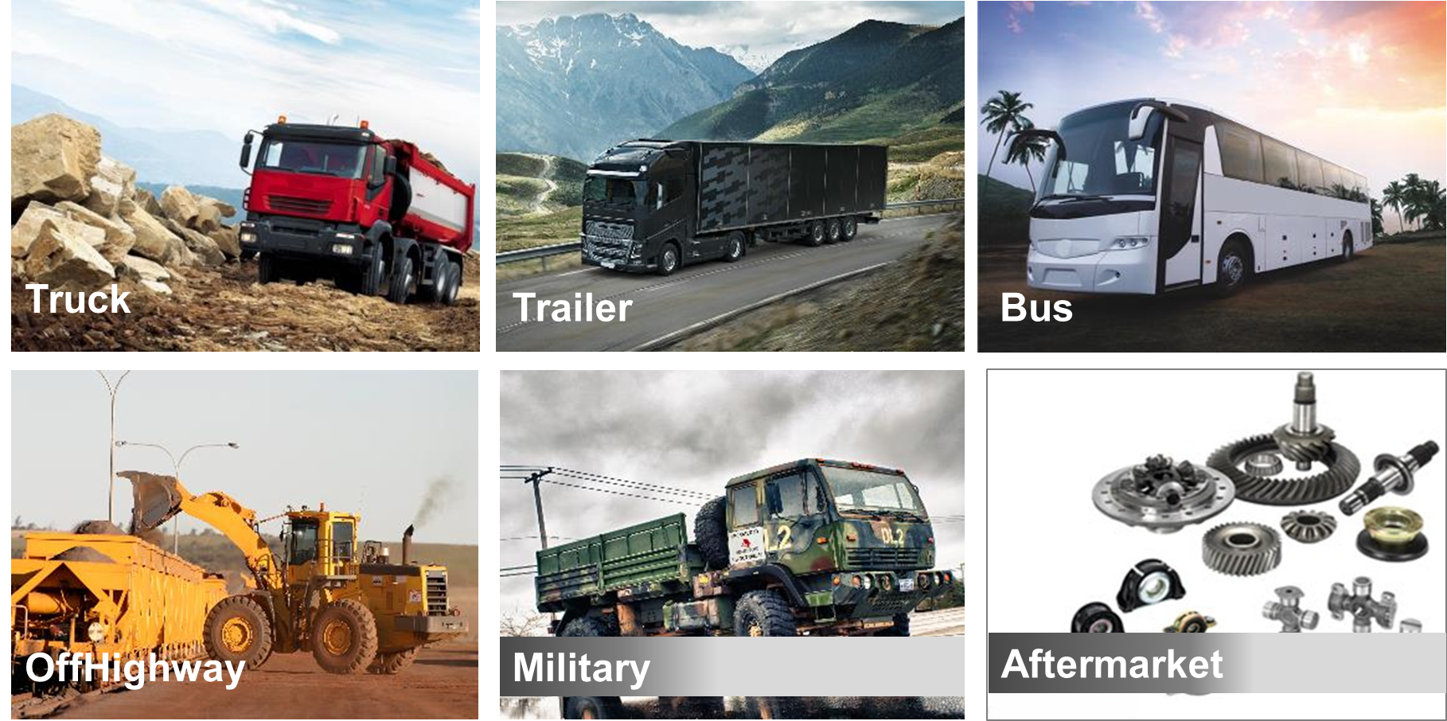
Diverse End Markets and Major Customers
Diverse End Markets
Major Customers

Slide 4
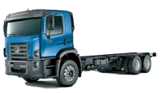
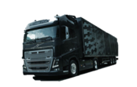
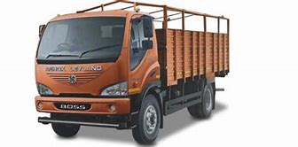
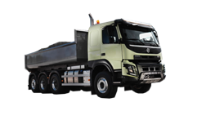
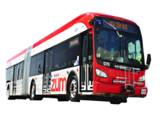
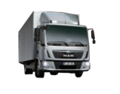
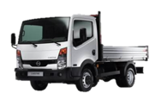
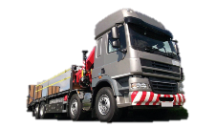
Most Comprehensive Axle & Brake Offerings
Axle
10X
11X
120
13X
14X
150
240
17X
160
EVO
18X
19X
610
Brake
310
360
394
410 / 22.5 ADB
410G
Light
Medium
Heavy
Extra Heavy

Slide 5
Financials
Values in INR Mn
Quarterly Performance
YTD Performance
v
Sales
19%
Sales
34%
EBIDTA
EBIDTA
PBT
PBT

Slide 6
2019 Outlook
Values in INR Mn
Full Year Outlook
Key Highlights
Sales
22% to 25%
Revenue:
22% to 25% growth YOY
Capacity ramp up completion by March / April 2019
EBITDA:
Commodity price change exerting pressure on EBIDTA%
Continuous Strategic plans to improve Productivity and cost is on track to manage the challenges
Continuous monitoring and control of fixed cost
CASH:
Improve Q4 cash flow
No working capital borrowing
EBIDTA
PBT

Slide 7
Quarterly Performance Q1FY12 – Q3FY19

Slide 8
Key Strategic Initiatives Update
Capacity Expansion
Business Wins
New product
Footprint Expansion

Slide 9
Revenue Growth Trend

